Slide 1
Accounting Information Systems
PRESENTED BY: EDGAR OTIENO
Lecture 5
Transaction Cycles: The Expenditure Cycle: Purchases and Cash Disbursements
Notes:
3

Slide 2
Objectives for Lecture 5
Tasks performed during purchases and cash disbursement processes
Departments involved in purchases and cash disbursement activities and the flow of these transactions through the organization
Documents, journals, and accounts that provide audit trails, promote the maintenance of records, and support decision making and financial reporting
Risks associated with purchase and cash disbursements activities and the controls that reduce these risks
Operational features and the control implications of technology used in purchases and cash disbursement systems
Notes:
3

Slide 3
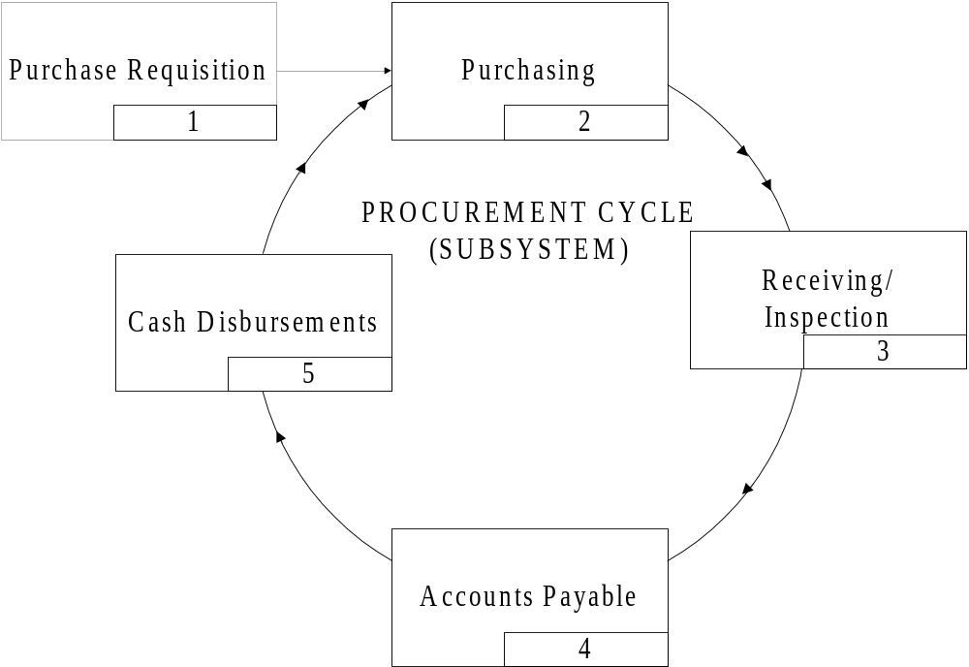

Delivery
Notes:
The time lag splits the expenditure transaction cycle into two phases
physical phase (purchasing cycle)‏
financial phase (cash disbursements)‏
The payroll cycle is typically kept separate from the other cash disbursements

Slide 4
Goals of the Expenditure Cycle
The goal of providing needed resources to organization can be broken down into several objectives:
  purchase from reliable vendors
  purchase high quality items
  obtain best possible price
  purchase only items that are properly authorized
  have resources available when they are needed
  receive only those items ordered
  ensure items are not lost, stolen, or broken
  pay for the items in a timely manner
Notes:
2

Slide 5
Computer-Based Accounting Systems
CBAS technology can be viewed as a continuum with two extremes:
  automation - use technology to improve efficiency and effectiveness
  reengineering – use technology to restructure business processes and firm organization
Notes:
21

Slide 6
Levels of Automating and Reengineering Ordering
Computer generates PR
  Purchases manually generates PO
Computer generates PO (no PR needed)‏
  PO not sent until manually reviewed
Computer-generated PO is automatically sent without manual review
Electronic Data Interchange (EDI)
  Computer-to-computer communication without PO
Notes:
2

Slide 7
Expenditure Cycle Database
Master Files
  supplier (vendor) master file
  accounts payable master file
  merchandise inventory master file
Transaction and Open Document Files
  purchase order file
    open purchase order file
  supplier’s invoice file
  open vouchers file
  cash disbursements file
Other Files
  supplier reference and history file
  buyer file
  accounts payable detail file
Notes:
2

Slide 8
Computer-Based Cash Disbursements
Tasks performed automatically by the computer:
  the system scans for vouchers currently due
  prints cheques for these vouchers
  records these cheques in the cheque register
  batch totals are prepared for the general ledger update procedure
Notes:
20

Slide 9
Advantages of Real-Time Data Input & Processing Over Batch Processing
Shortens the time-lag in record-keeping; hence, records are more current
Eliminates much of the routine manual procedures, such as transcribing information onto paper documents
Eliminates much of the storage and shuffling of paper documents
Reduces data entry correction procedures
Notes:
2

Slide 10
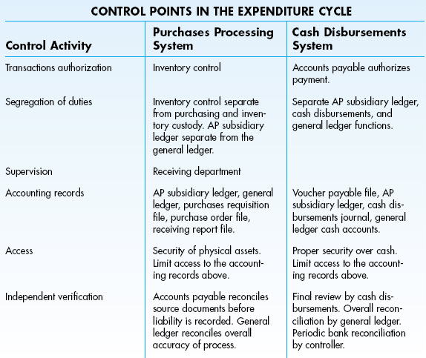
Summary of Internal Controls

Slide 11
General Internal Controls
Organisation controls
  segregation of duties
Documentation
Asset Accountability Controls
Management Practices
Data Center Operations Controls
Authorisation Controls
Access Controls
Notes:
2

Slide 12
Computer-Based Authorization Controls
Authorisations are automated.
  programmed decision rules must be debugged
Automating inventory in EDI and JIT
  faulty inventory model can lead to over-purchasing or under-purchasing
Cash disbursements may automate cheque printing and signing.
  programming logic must be flawless
  automated signing only below a dollar threshold
Notes:
2

Slide 13
Traditional Segregation of Duties
Warehouse (stores)‏
Inventory control
Accounts payable
General ledger
Requisitioning
Purchases
Purchases returns and allowances
Cash disbursements
Notes:
2

Slide 14
Computer-Based Segregation of Functions
Extensive consolidation by the computer of tasks traditionally segregated
  computer programs authorise and process purchase orders
  computer programs authorise and issue cheques to vendors
Notes:
2

Slide 15
Computer-Based Supervision
Automation often leads to a collapsing of the traditional segregation of duties.
  requires greater supervision
Supervision takes on new aspects as technology advances.
  electronic monitoring
Supervision because more difficult as the workplace becomes more sophisticated.
  employees may have advanced IT training
Notes:
2

Slide 16
Computer-Based Accounting Records
Accounting records rest on the reliability and security of stored digitalized data.
  Accountants should be skeptical about the accuracy of hard-copy printouts.
  Backups - the system needs to ensure that backups of all files are continuously kept
Most automated systems still have a lot of paper documents.
  This is good for audit trail purposes but is often inefficient.
  As the system becomes increasing paperless, maintaining an audit trail becomes more difficult.
Notes:
2

Slide 17
Computer-Based Access Controls
Magnetic records are vulnerable to both authorised and unauthorised exposure and should be protected
  must have limited file accessibility
  programs must be safeguarded and monitored
Notes:
2

Slide 18
Computer-Based Independent Verification
Automating the accounting function reduces the need for verification by reducing the chances of fraud and error in the expenditure cycle.
However, the need for verification shifts to the computer program and the programmers where fraud and error may still be present.
Notes:
2

